Slide 1
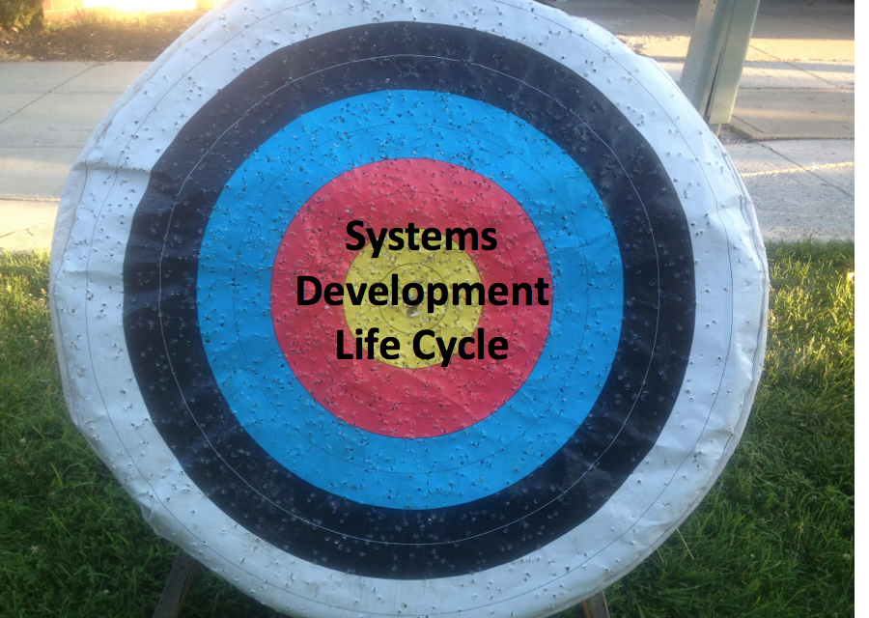

Slide 2

Client & Engineer

Slide 3
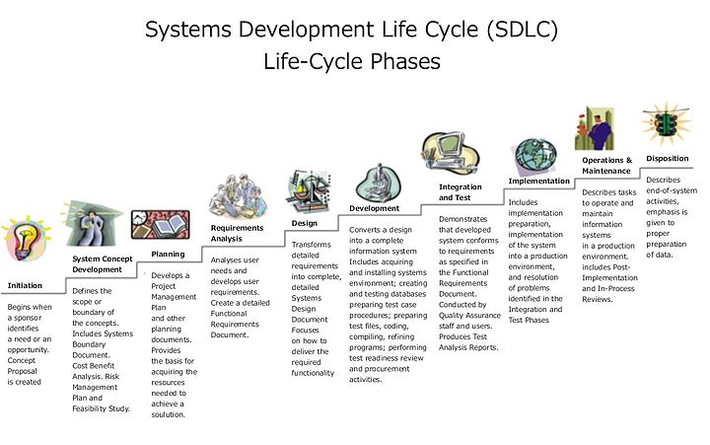

Slide 4
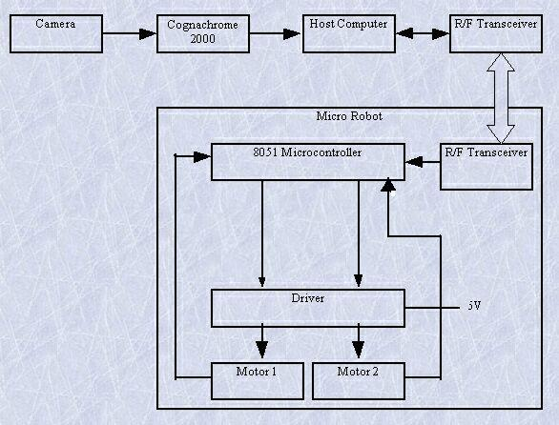
Block diagram

Slide 5
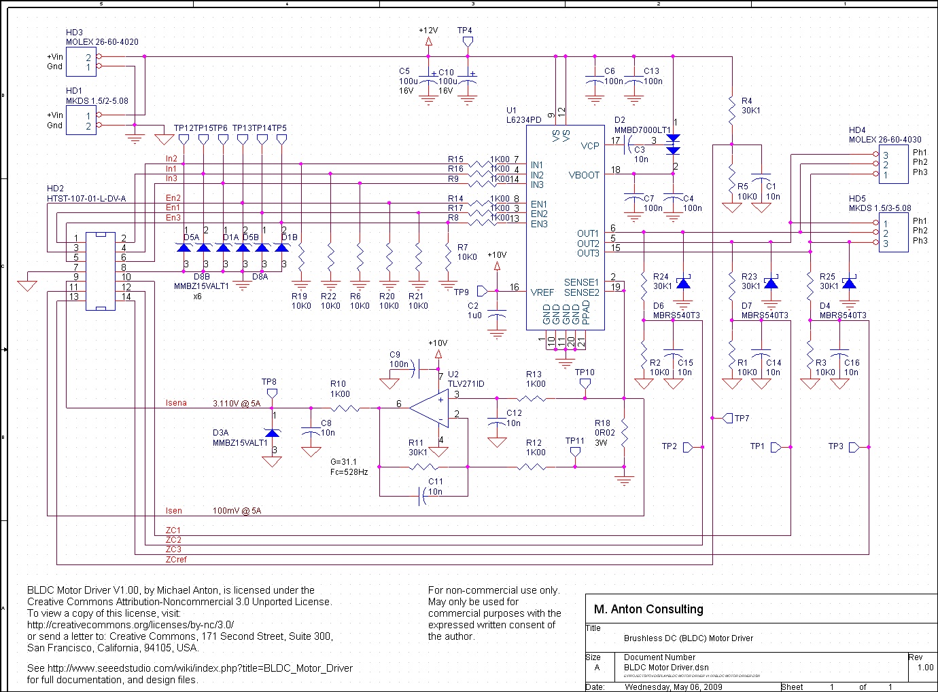
Schematic

Slide 6
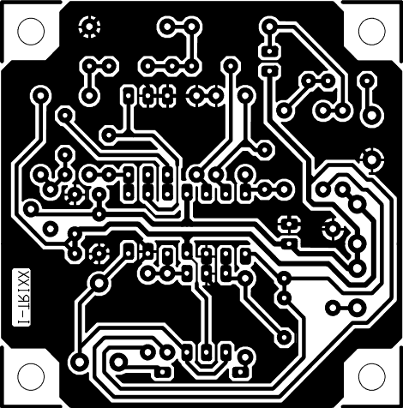
Pcb design

Slide 7
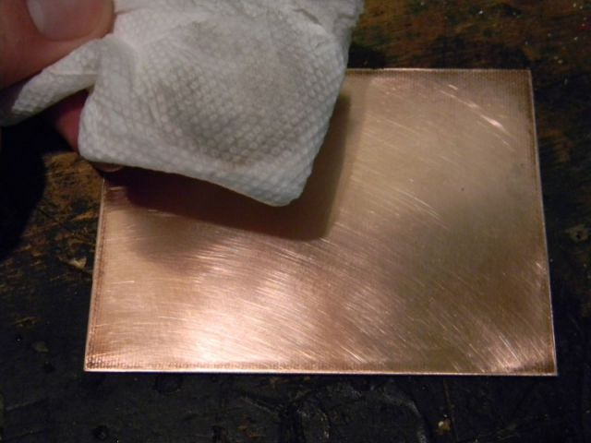
Copper plate

Slide 8
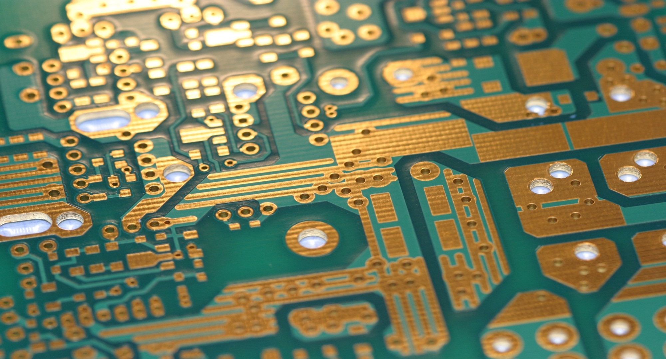
Pcb fabrication

Slide 9
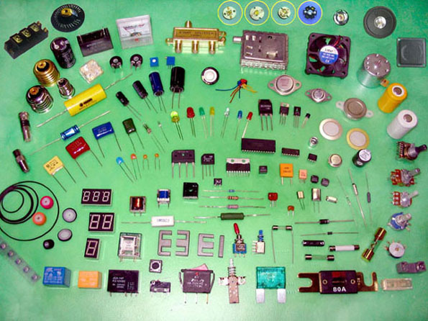
Hardware Components

Slide 10
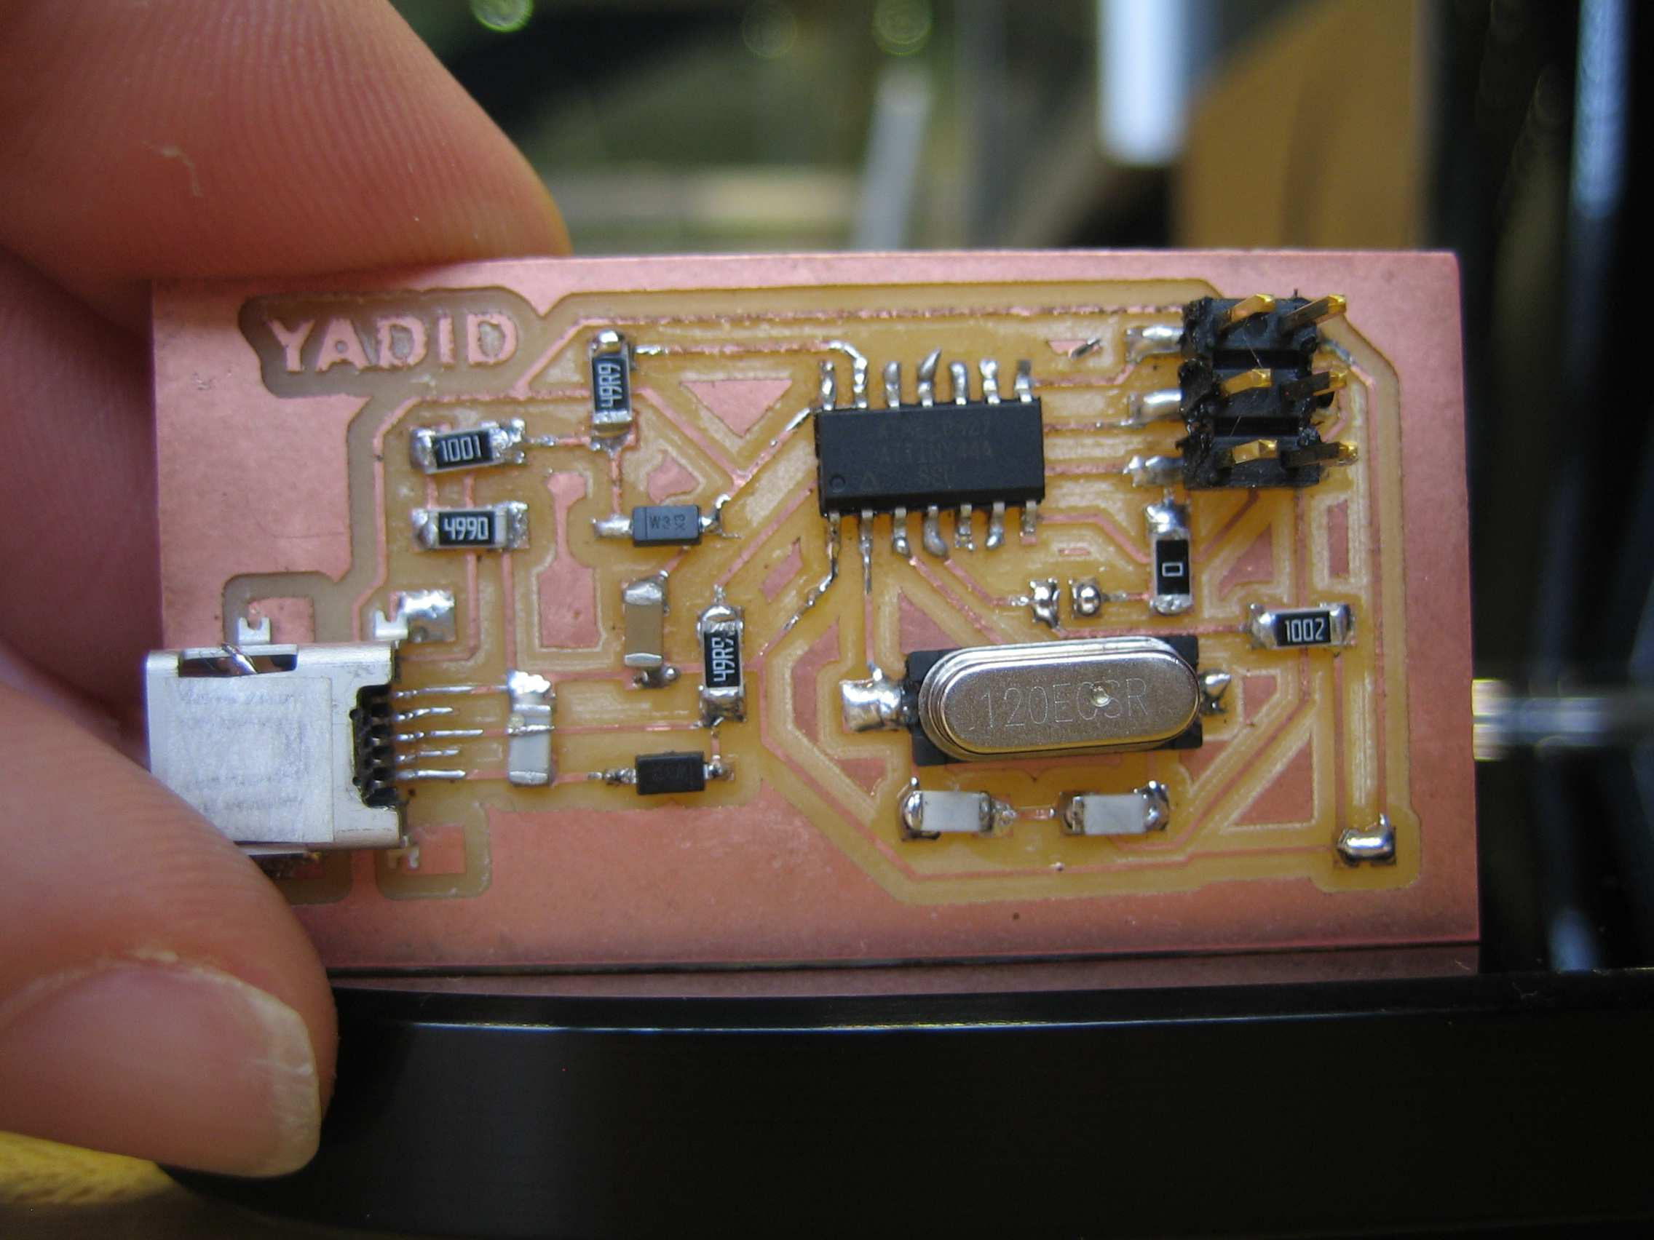
Pcb board with components

Slide 11
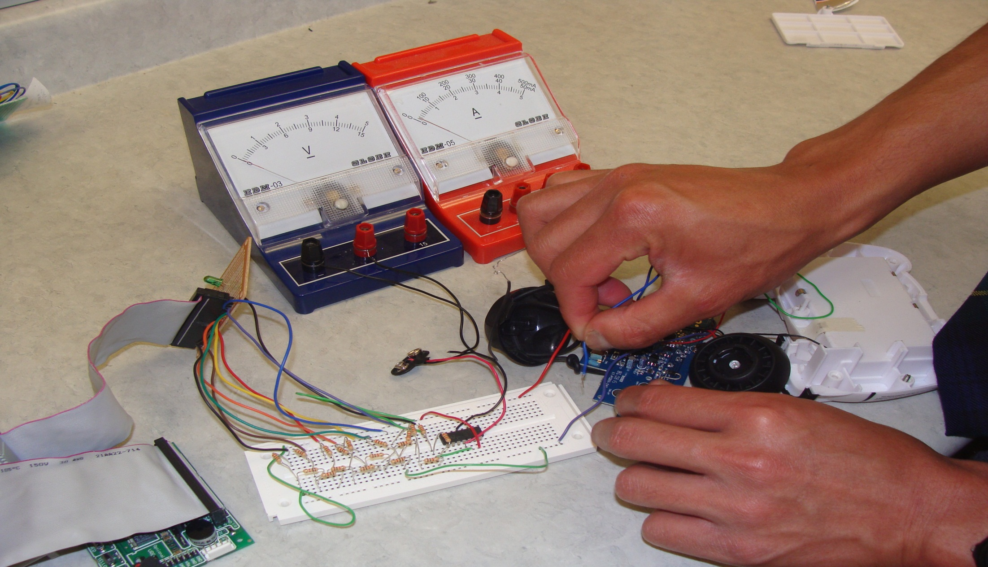
Hardware Testing

Slide 12
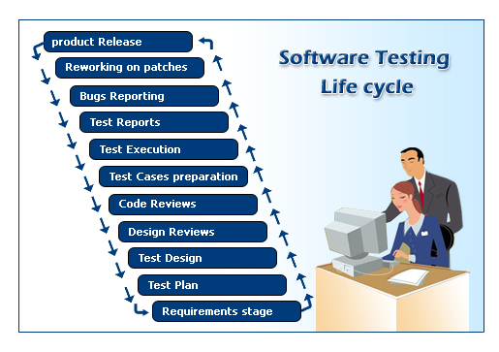
Software Testing

Slide 13

Marketing

Slide 14
Basic Components
Monday, January 28, 2013

Slide 15
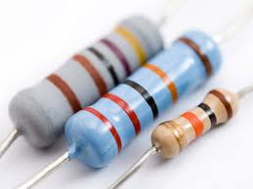
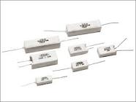
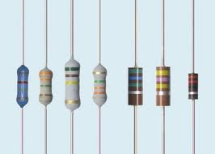
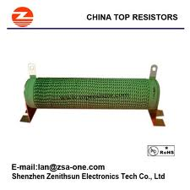
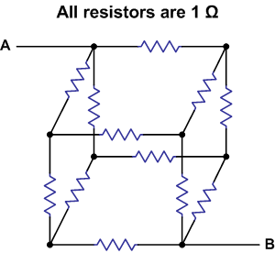
Resistor
Monday, January 28, 2013

Slide 16
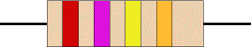
RESISTOR:
A resistor is a device which opposes the flow of current.
The first band gives the first digit The second band gives the second digit The third band indicates the number of zeroes.
Monday, January 28, 2013
WineYard technologies

Slide 17
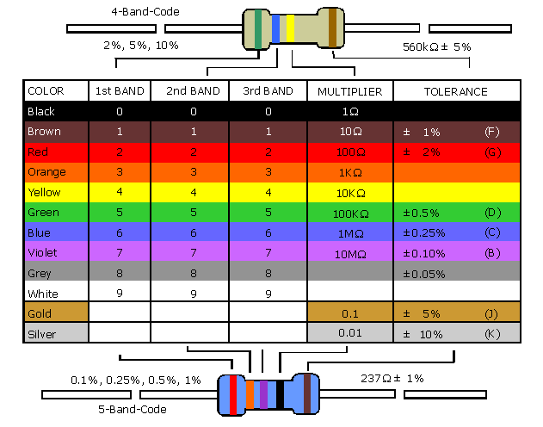
Colour coding

Slide 18
Types of Resistors
Fixed Resistors
Carbon Composition Resistors
Carbon film Resistors
Metal film Resistors
Wire wound Resistors
Power Style
Precession Style
Monday, January 28, 2013

Slide 19
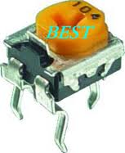
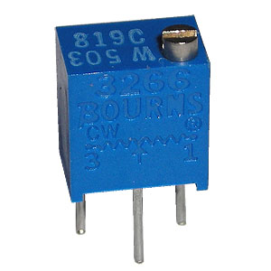
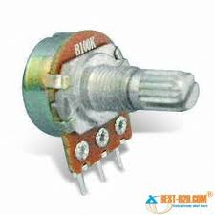
Variable Resistors
Potentiometer
Preset
Trimmer
Monday, January 28, 2013

Slide 20
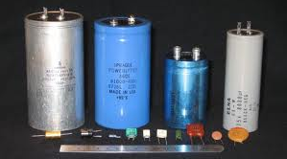
Capacitors
Monday, January 28, 2013

Slide 21
CAPACITORS:
Capacitor is a Passive component manufactured with some value of capacitance
A Capacitor has two conducting plates separate by an insulting & dielectric media.
Capacitors are passive elements which can able to store the energy in the form of electricity
Monday, January 28, 2013

Slide 22
Types of Capacitors
Capacitors types...
Electrolyte Capacitors (>1µF)
Ceramic / Disc Capacitors (<1µF Low power App)
Polyster Capacitors (<1µF High power App)
Monday, January 28, 2013

Slide 23
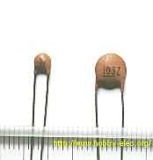
Identification of disc capacitor
capacitor block DC (constant) signals
capacitors easily pass AC (changing) signals
s
Monday, January 28, 2013

Slide 24
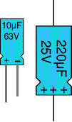
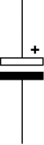
Electrolytic Capacitor
Monday, January 28, 2013

Slide 25
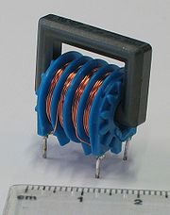
INDUCTOR:
An inductor or a reactor can store energy in a magnetic field created by the electric current passing through it. It is denoted in Henry.
Typically an inductor is a conducting wire shaped as a coil, the loops helping to create a strong magnetic field inside the coil due to Faraday's Law of Induction.
Inductor easily pass DC (constant) signals
Inductors blocks AC (changing) signals
Monday, January 28, 2013

Slide 26
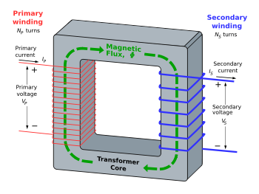
Transformer:
Monday, January 28, 2013
WineYard technologies

Slide 27
DIODE:
A Diode is a two terminal electronic component that conducts electric current only in one direction.
Based on applications diodes are divided into two types
-> PN junction
-> ZENER diode
Monday, January 28, 2013
Monday, January 28, 2013
WineYard technologies
WineYard technologies

Slide 28
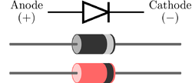
PN junction diode:
The most common function of a diode is to allow an electric current in one direction (called the forward direction) while blocking current in the opposite direction (the reverse direction).
Monday, January 28, 2013

Slide 29
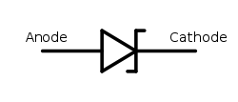
ZENER DIODE:
A Zener diode is a type of diode that permits current in the forward direction like a normal diode, but also in the reverse direction if the voltage is larger than the breakdown voltage known as "Zener knee voltage" or "Zener voltage".
Monday, January 28, 2013

Slide 30
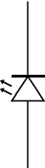
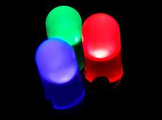
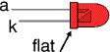
LIGHT EMITTING DIODE (LED) A light-emitting diode (LED) is a semiconductor light source. LED’s are used as indicator lamps in many devices, and are increasingly used for lighting.
k
A
Monday, January 28, 2013

Slide 31
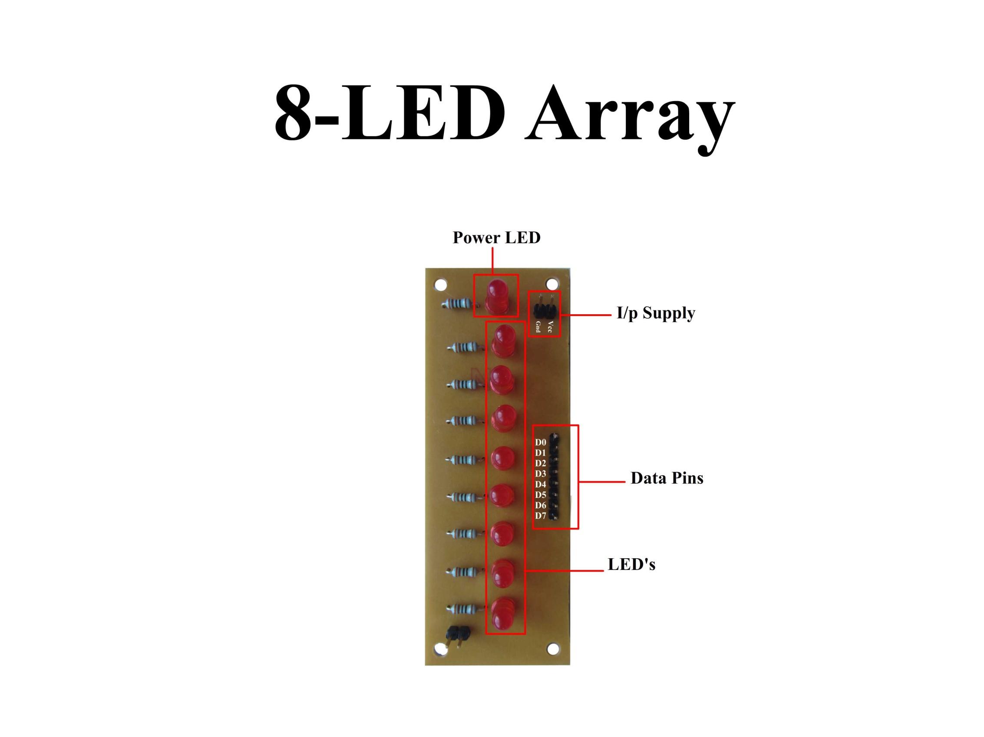

Slide 32
Materials Used in LED’s
The materials used in LED’s are the mixtures of Galium (Ga), Arsinide (As), Phosphorous (P).
The materials include->>>>GaAs, GaP, GaAsP
GaAs-----------------Emits IR light which is invisible
GaP------------------ Emits Red and Yellow Colors
GaAsP--------------- Emits Red and Green Colors
Monday, January 28, 2013

Slide 33
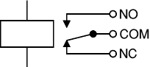
RELAY: A Relay is an electrically controllable switch widely used in industrial controls, automobiles, etc…
inductor
Monday, January 28, 2013
WineYard technologies

Slide 34
Types:
SPDT
DPDT
SPST
DPST
Symbol Of Relay:
Monday, January 28, 2013
WineYard technologies

Slide 35
SPDT Relay (Single Pole Double Throw) :
An electromagnetic switch, consist of a coil , 1 common terminal , 1 normally closed terminal , and one normally open terminal. When the coil of the relay is at rest (not energized), the common terminal and the normally closed terminal have continuity. When the coil is energized, the common terminal and the normally open terminal have continuity.
Monday, January 28, 2013

Slide 36
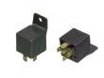
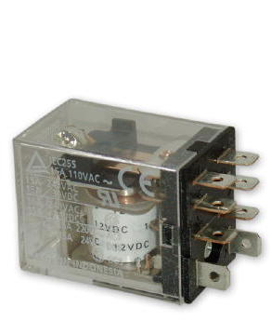
SPDT & DPDT:
Monday, January 28, 2013

Slide 37
Diagrammatic explanation:
N/C
AC
230V
IRON
ARM
COM
INDUCTOR
ON
BULB
N/O
OFF
Monday, January 28, 2013
WineYard technologies

Slide 38
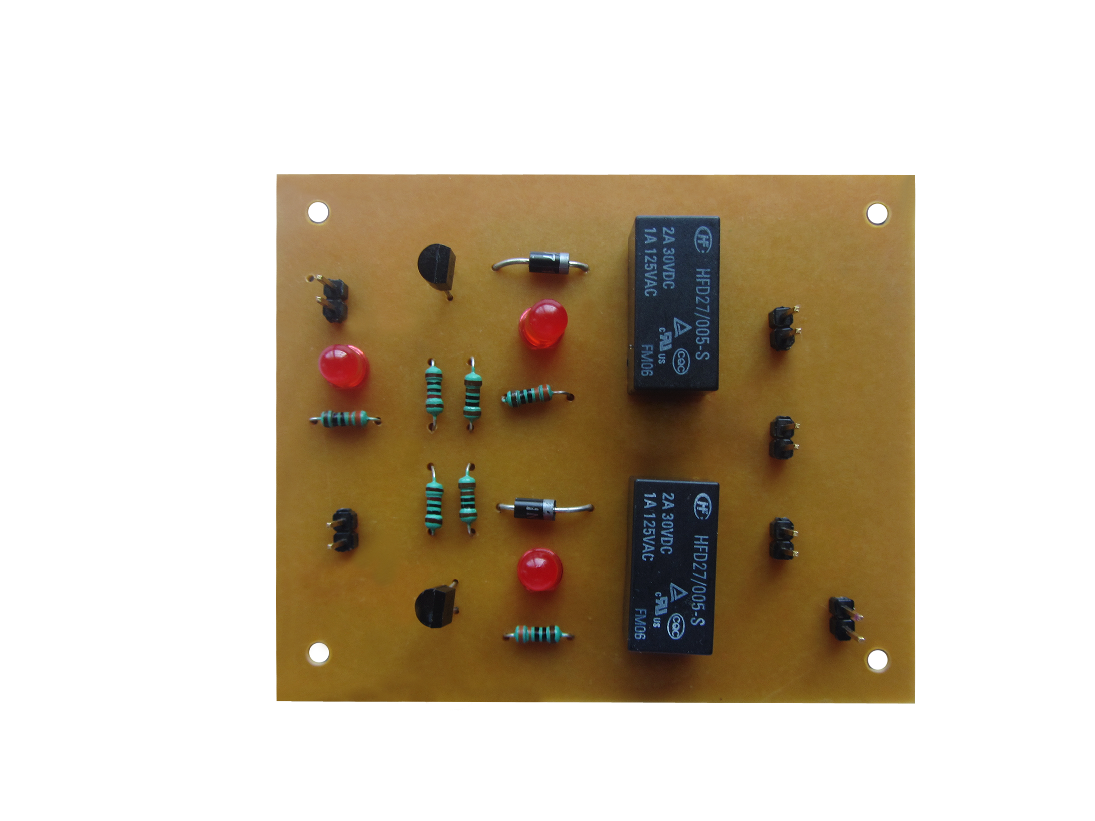

Slide 39
What is a switch?
In electronics, a switch is an electrical component that can break an electrical circuit, interrupting the current or diverting it from one conductor to another.
Monday, January 28, 2013
WineYard technologies

Slide 40
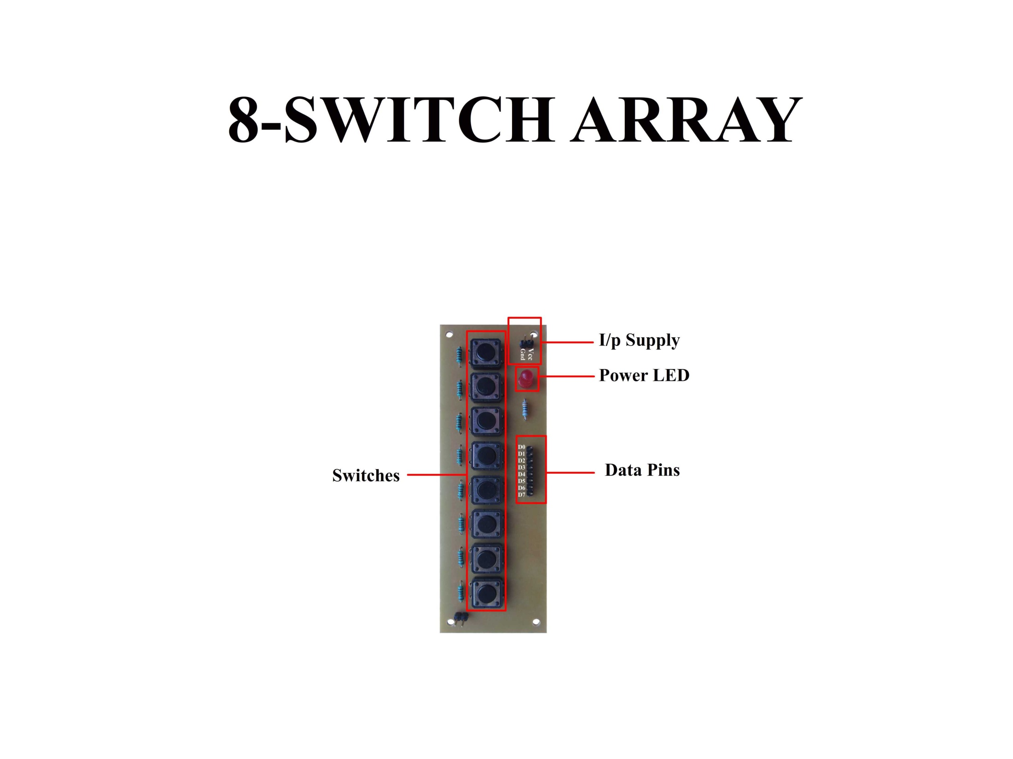

Slide 41
Transistor as a switch:
Transistor can be used as an electronic switch, in grounded-emitter configuration.
Transistors are commonly used as electronic switches, for both high power applications including switched mode power supply and low power applications such as logic gates.
Monday, January 28, 2013
WineYard technologies

Slide 42
Transistor basics:
Transistors can be regarded as a type of switch.
Transistors are manufactured in different shapes but they have three leads (legs). The BASE - which is the lead responsible for activating the transistor. The COLLECTOR - which is the positive lead. The EMITTER - which is the negative lead.

Slide 43
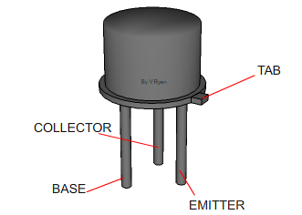
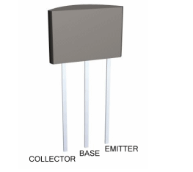
TWO EXAMPLES OF DIFFERENT SHAPES OF TRANSISTOR:

Slide 44
Types of transistors:
Two types of transistors:
1.PNP transistor
2.NPN transistor

Slide 45
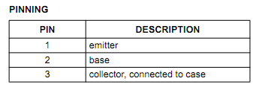
FEATURES & APPLICATIONS OF PNP & NPN Transistors:
FEATURES:
• High current (max. 600 mA)
• Low voltage (max. 60 V).
APPLICATIONS:
Switching and linear amplification.

Slide 46
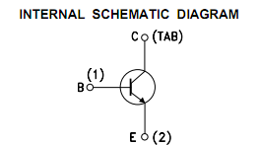
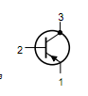
NPN Transistor & PNP Transistor:
NPN Transistor
PNP Transistor

